Slide 1

TRIVIA DATABASE & EVENT GENERATOR
By: Alissa Trujillo
Notes:
Hi everyone, my name is Ali and today we will be looking at my current project, creating a trivia database with the ultimate goal of users generating their very own trivia event.

Slide 2

WHAT MAKES A GOOD TRIVIA EVENT?
Questions of varying difficulty, or varying amounts of knowledge required
A cohesive theme
Clear wording, one distinct correct answer
A great atmosphere
Notes:
As someone who frequents trivia events, there are a couple guidelines that make a trivia event successful. The first is to have questions of varying degrees of difficulty. Some questions should be able to be answered by anyone familiar with the topic, while some will require a deeper understanding. The next important piece is to have a cohesive theme. Even if the theme is very generic, such as “general pop culture” trivia or “movies & tv”, it gives the audience an idea of what to expect so they come prepared. The topics can range from broad, to very specific, such as a trivia night focused solely on the TV show “Friends”. In determining questions, it is very important that the questions are worded clearly and do not lead to confusion over the correct answer. This many times will require the host to have a deep understanding of the topic at hand, to ensure that there can be no dissenting answers. The last piece is just having an overall great atmosphere. The venues that typically host events like this tend to be local bars and breweries, and it is a great way to try new places and support your local businesses!

Slide 3

OUR GOAL
Notes:
Our goal is to create a straight-forward, simplified process where users can create their own trivia event. We aim to take the researching, organization, and question selection elements out of it so our hosts can focus on putting together the event and ensuring everyone has a great time.

Slide 4
USER-INTERFACE FLOW
USER INPUT
FETCH FROM DATABASE
CREATE DOWNLOADABLE PDF
Notes:
There are three stages of this project. The user-facing component is the interactive application that will allow them to specify their own parameters. These parameters will then be used to query the database to determine which questions match their preferences. The final output will be a downloadable PDF that contains a randomly generated set of questions based on their parameters, including all the necessary pieces of information they need to host their event. We will talk about each of these a little further in detail.

Slide 5

THE DATABASE
Notes:
The database contains numerous questions covering various topics. Each entry contains the question, the correct answer, the difficulty of the question, a unique identifier, and the source for the question. This allows the host to ensure the information is always up-to-date and correct, and if patrons have questions, they can reference the source to provide further information. For the sake of this project, questions whose answers are subject to change were omitted. This maintains the integrity of the questions regardless of when the database is accessed. The database was created using sqlite3 and compiled using Python. It currently only contains roughly 100 questions in one table, however as it grows the database manager will keep an eye on its size and eventually break it down into multiple tables based on intrinsic qualities of the data.

Slide 6
ASSESSING THE DATABASE
Strong enough to store relevant data
All tables have a means of relation to other tables
Provides different views to different users
Data Integrity
Data Independence
Data Redundancy
Data Security
Data Maintenance
Notes:
There are certain qualities a database must have in order to be effective. The database must be strong enough to store relevant data, and with the fairly small amount of data we have now, we have plenty of remaining memory. All tables must have a means of relation to other tables. Currently we only have one main table, but as the data expands and we add more, we will ensure they have the proper connections to each other. The database provides different views to different users. The end-user application allows the user to interact with the database in an aesthetic fashion, while myself as the database manager can run queries through Python. Data integrity is maintained, as all questions were verified for accuracy before they were added to the pool. In terms of data independence, the database and the user-application are stored separately, so if one is inoperational, the other will not be affected. The user-application is programmed to refer to a cached CSV containing the questions if it cannot connect to the database. As for data redundancy, each question only appears in the database once. If we do create multiple tables, this may be lessened as there might be multiple references to the questions. When it comes to data security, I have not taken any additional steps to encrypt the data, however it is all publicly known knowledge and contains no personal information. And lastly, data maintenance will be performed as we move forward and add more questions to the database, ensuring that everything is still running smoothly.

Slide 7
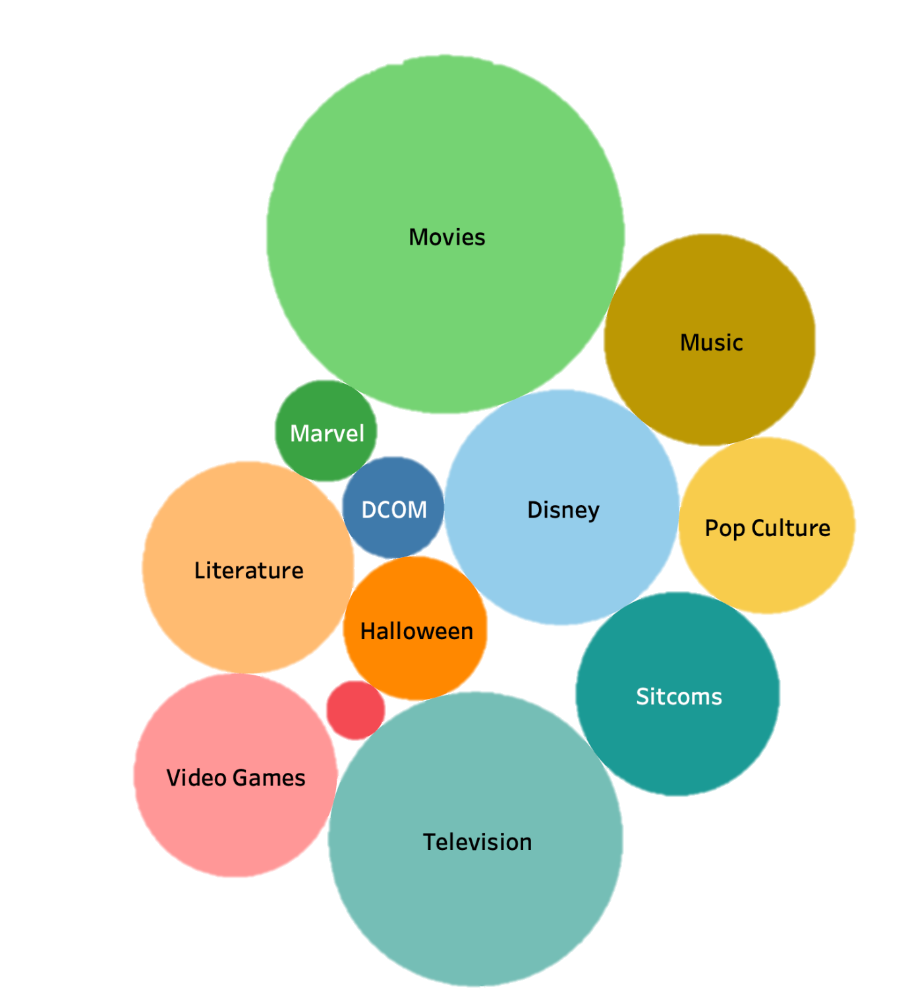
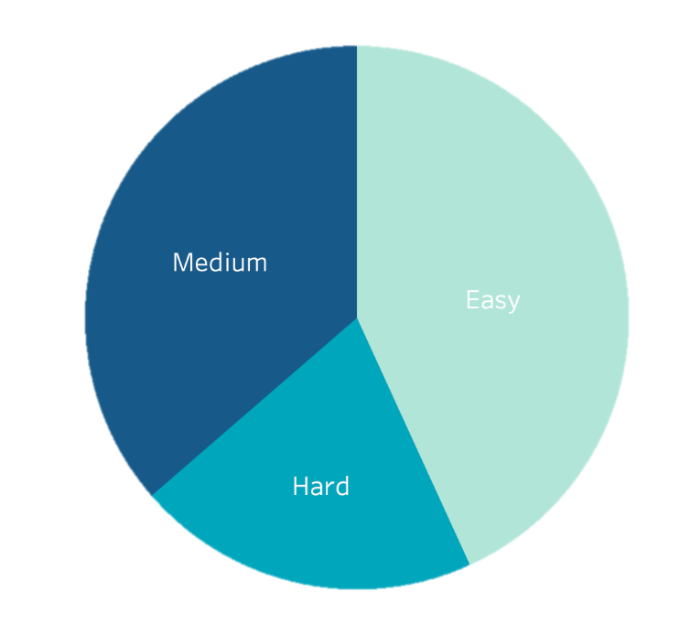
THE QUESTIONS
Notes:
These graphics allow us to get a good luck at the breakdown of questions in the database. We have a good mix of difficulty, with easy questions having a bit higher of a share. In terms of topics, we can see there are many different topics represented, with movies and television having the largest number of questions. Of course, as the database continues to grow, these numbers will change, so this is just a current snapshot in time.

Slide 8
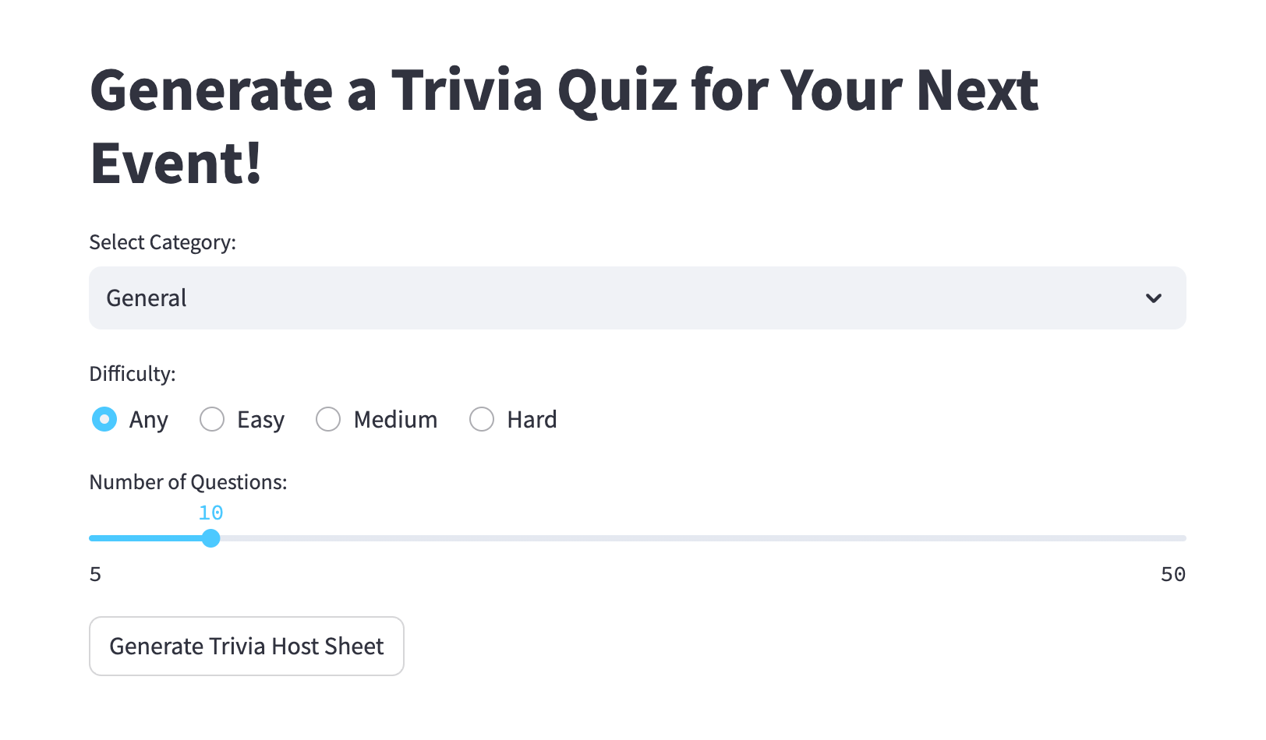
THE APPLICATION
Notes:
The application is the user-facing element. It allows them to enter their preferences to the system, which will then query the database for matching questions. The categories that populate as choices will be any category that has at least 10 questions. The slider bar will also adjust based on the number of actual available questions for that topic, with a maximum of 50. The button at the bottom will feed the choices to the system, randomly select questions that match the preferences, and create the output sheet for the user.

Slide 9
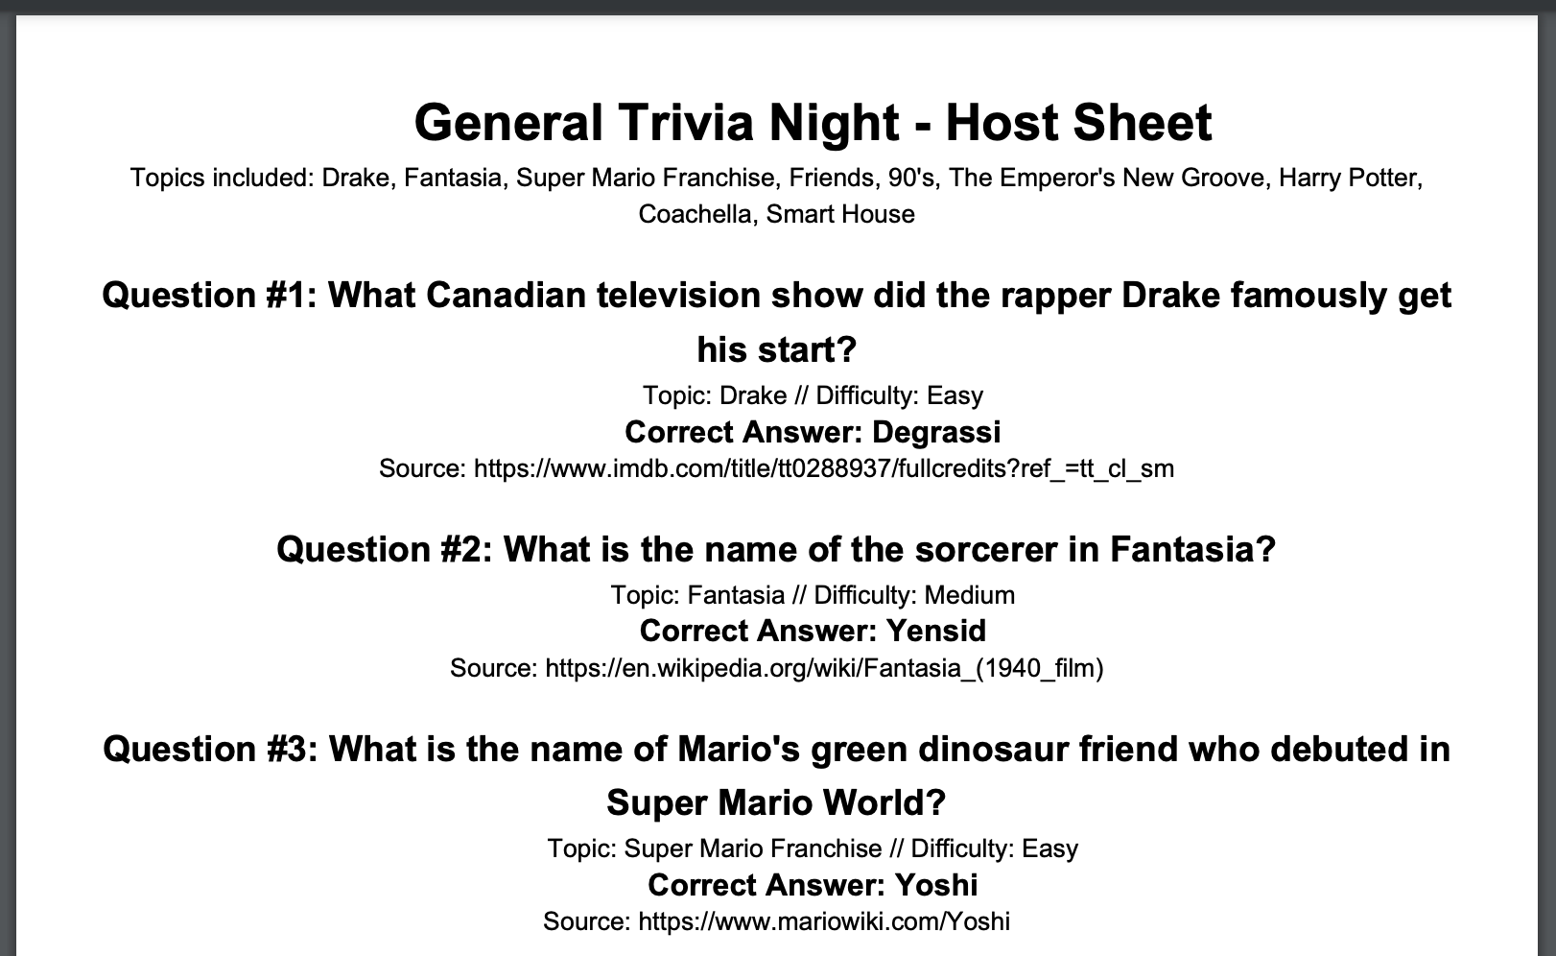
THE PDF
Notes:
The output PDF will look something like this. At the top, we have our topic that is chosen by the user, in this case “General” trivia. We also see a list of topics that are included in the generated game, which we can see is a wide variety for our general trivia. Drake, Fantasia, the Super Mario Franchise, Friends, the 90’s, and so many more. This gives our host an overview of what the evening will look like. Then we have the generated questions, which denotes the difficulty, the specific topic of the question, the correct answer and the source right there for the host for verification if questions arise.

Slide 10

Q&A
1. How do you actually quantify a successful trivia night?
Notes:
This answer may vary by venue to venue, but the main question I would ask is: how many patrons are here, that would not be here if we were not hosting trivia this evening? We can look at the differences between normal patronage (and of course, sales) on a normal Tuesday vs. a Trivia Tuesday

Slide 11
Q&A
2. What criteria must questions meet to be added to the database?
Notes:
All questions are vetted to be clearly written, with one specific target answer. They must also have reputable sources that back up their truthfulness. We also would like to keep them fairly concise, something that would require multiple sentences of backstory would likely not be selected.

Slide 12
Q&A
3. What is the distinction between a category and a topic?
Notes:
The categories are broader, things such as movies, music, or television. The topics will be more precise, and will typically reside within the broader topics. Topics include things like “Star Wars”, “Parks and Recreation” and “Animal Crossing”. It is possible for a topic or question to fall within multiple categories, for example a question about Hermione in the Harry Potter series could be categorized under both “Movies” and “Literature”.

Slide 13
Q&A
4. How does the program that generates trivia work?
Notes:
The generator works by first taking the input from the user-interface, then searching the database for matching questions. If the question matches the selected category or topic, it is flagged as “topical” and eligible to be chosen. Once all questions are flagged, the generator will randomly choose from that subset of questions. Those questions are then integrated into the PDF print out for the user.

Slide 14
Q&A
5. What are considered credible sources for answers?
Notes:
There are many sources that are considered credible, IMDB is a huge resource for anything movie or television related. Dedicated wiki pages for certain fandoms are useful as well, they typically will reference further sources to assert their credibility as well. I strayed against any pages that just listed trivia facts with no reputable secondary references.

Slide 15
Q&A
6. How is question difficulty determined?
Notes:
Question difficulty is assessed based on the level of proficiency someone would have to have in a particular topic in order to know the answer. For easy questions: most users will have a general familiarity with this concept, you do not have to have extensive knowledge (or even watch the movie, read the book, etc.) in order to have access to this information (for example, the Rachel hair-do was so big in pop culture that you did not need to watch the show to know what it is)
For medium questions: users will need to have a little bit of specialized knowledge with this concept to know the answer, but a casual fan (say, someone who watches reruns of Friends) will have a chance to know this answer
For hard questions: users will need in-depth specialized knowledge to answer this question correctly (so, someone who has watched every single episode of Friends)

Slide 16
Q&A
6. What is considered “general” trivia?
Notes:
General trivia is the default setting on the user-interface application. It tells the system that anything goes, and any question may be used in generating the trivia sheet. This will include a wide array of topics, from horror movies to music festivals to everything in between.

